Slide 1
What is Data Lakehouse?
Differences between data lake, data lakehouse and data warehouse

Slide 2
Agenda
Qivada
Basics Definition of terms and short comparison
Scenarios Commonly seen approaches “in the wild”
Data Lakehouse vs. Data Warehouse What does it actually mean in real life?
Data Lakehouse Basics
Getting Started Helpful information how to get started

Slide 3





Qivada in Short
Company established in 2022 as a carve-out subsidiary of Enfo Oyj
Main product, cloud-native Analytics Development Accelerator ADA, with its history dating back to 2010
ADA enables Customers & Partners to
Automate data utilization with fast time to market
Cut down routine work in DataOps development by up to 70%
Improve on agility to respond to data consumers’ needs
Enhance on meaningful workdays for DataOps professionals
Pay-as-you-go, commercially fitted for organizations or projects of all shapes & sizes, available on Azure Marketplace
Some of Our Customers

Slide 4
Basics
Definition of terms and short comparison

Slide 5
Basics
Definition of terms
Data Lake
A data lake is a centralized repository designed to store, process, and secure large amounts of structured, semi structured, and unstructured data.
Data Lakehouse
Combines flexibility, cost-efficiency, and scale of data lakes with the data management and ACID transactions of data warehouses, enabling business intelligence (BI) and machine learning (ML) on all data.
Data Warehouse
A data warehouse is a type of data management system that is designed to enable and support business intelligence (BI) activities, especially analytics. Data warehouses are solely intended to perform queries and analysis and often contain large amounts of historical data.

Slide 6
Basics
Short comparison
 | Raw Data | Schema | BI | ML | Realtime ETL ^{(*}
Data Lake | X | - | - | X | X
Data Lakehouse | X | X | X | X | X
Data Warehouse | - | X | X | X | -
Generalization between data lake and data lakehouse
Data lake stores the data as it is enabling processing of the data
Data lakehouse is data lake topped with data warehouse capabilities
^{(*} Capability to transform raw -and structured data to analytical data as soon as it is available (event-based processing)

Slide 7
Scenarios
Commonly seen approaches “in the wild”

Slide 8
Classic
On-premise
Solution contains only data warehouse
Data Warehouse
Reporting
DB
File
Remarks
Solution is built and modeled based on data warehousing requirements
Capability to store, process and prepare unstructured data is limited
REST

Slide 9
Standard
Common approach on cloud
Solution contains data lake and data warehouse
Data Lake
Data Warehouse
Reporting
DB
File
Remarks
Capability to store, process and prepare unstructured data
Data processing is split to; Data acquisition (Data lake) and data analytics (Data Warehouse)
REST

Slide 10
Advanced
Standard + real-time analytics / “raw data” reports
Solution contains data lakehouse and data warehouse
Data Lakehouse
Data Warehouse
Reporting
DB
File
Remarks
Data lakehouse is continuum of data lake to provide prepared data
Parts of data warehouse is implemented with data lakehouse
REST

Slide 11
Specialized
Point solution for specific requirements
Solution contains only data lakehouse
Data Lakehouse
Reporting
DB
File
Remarks
Capability to store, process and prepare unstructured data
Data lakehouse provides prepared and transformed data for reporting
Commonly seen with:
Small environments
Environments requiring real-time ETL processing or specialized data transformations
REST

Slide 12
Data Lakehouse vs. Data Warehouse
What does it actually mean in real life?

Slide 13





Architecture
Commonly used components
Data Lakehouse
Data Warehouse
Compute
Read (Databricks)
[Method #2]
Read (SQL)
Databricks
Power BI
Database
Power BI
Access, process and transform
Read (SQL)
[Method #1]
Compute + Storage
Storage
Access
Compute
Storage
Azure Synapse Analytics (Serverless)

Slide 14
SQL Compatibility
Short comparison
 | Data Lakehouse [Databricks] | Data Lakehouse [Synapse Analytics (Serverless)] | Data Warehouse
ANSI compatible | X | Partial | X
JSON parser | X | Partial | X
XML parser | X | Partial | X
Data modification | X | Partial | X
Databricks has comprehensive support for SQL based data modifications
Azure Synapse Analytics (Serverless) is commonly used to only read (SELECT) data
Spark SQL, built-in Functions (Databricks)
https://spark.apache.org/docs/latest/api/sql/index.html

Slide 15
Data Lakehouse
Basics

Slide 16
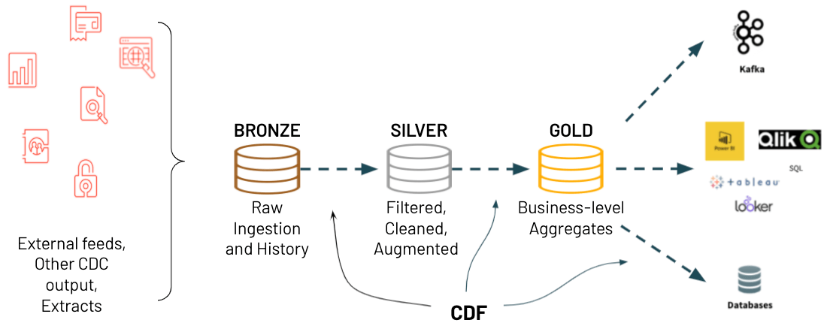
Medallion Architecture
Refine data through bronze, silver and gold tables
Keep it simple. Do not implement silver and gold if you do not require the functionality. The layers can be implemented later when required.

Slide 17
When to Use
Selection Chart
 | Data Lakehouse | Data Warehouse
Raw data reporting
Near Real-time
Query response time
Large data volume
Complex data
Cost efficiency
Skills availability
Maintainability
BI Tools Support

Slide 18
Getting Started
Helpful information how to get started

Slide 19
Resources
Documentation and starter pack
Medallion Architecture (Bronze, Silver and Gold)
https://www.databricks.com/glossary/medallion-architecture
Simplify Your Medallion Architecture with Delta Lake’s CDF Feature
https://www.databricks.com/notebooks/delta-lake-cdf.html
What is Delta Lake?
https://docs.databricks.com/delta/index.html
Starter pack
https://github.com/Qivada/ADA

Slide 20
Thank you
Ari Rämö
Partner, Product development
+358 50 367 4561
ari.ramo@qivada.com
qivada.com

